Slide 1

AI-Integrated Web Tool
for Personalized Study Planning
(AI Tutor)
Mentor : Revathi Venugari
Coordinator : Pradyumna V

Slide 2

Problem Statement
Traditional learning environments often fail to meet diverse student needs, creating significant challenges in academic success and engagement. Key struggles include:
Lack of personalized study plans.
Difficulty tracking progress effectively.
Generic, non-adaptive learning approaches.
Poor time management and inefficient scheduling.
Limited and delayed performance feedback.
Overwhelmed by unguided study material.
These issues highlight an urgent need for an AI-powered solution to create a more efficient, engaging, and adaptive study experience.

Slide 3

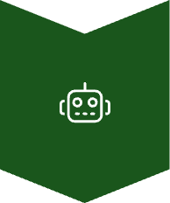



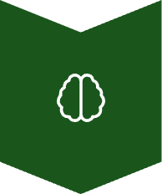

Project Overview
AI Tutor
Intelligent learning companion
Smart Analysis
Custom plans from syllabus, grades & preferences, data analytics, performance insights
Adaptive Learning
Quizzes & progress tracking for growth, real-time feedback, difficulty adjustment
Automation
Scheduling, notifications & progress reports
Intelligence
NLP processing, content generation, predictive analytics
Integration
Multi-platform, seamless experience
Goal: Transform student learning with data-driven academic support

Slide 4





Features
Personalized Daily Plans
Custom schedules generated from your syllabus and learning pace
Adaptive Quizzes
Smart assessments that adjust difficulty based on your performance
Interactive Dashboard
Visual progress tracking with real-time insights and task management
Smart Notifications
Timely reminders via email and in-app alerts for deadlines

Slide 5
Tech Stack
Frontend
Graphs/Charts
AI/NLP/Logic
HTML
Chart.js
Python
CSS
Recharts
spaCy
JavaScript
D3.js
NLTK
React
TextBlob
Tailwind CSS
scikit-learn
Scheduling/Database
Quiz Generation
Notifications
Timedelta (Python built-ins)
Template-based logic using NLP keywords
Firebase
Local storage or backend database
OneSignal

Slide 6
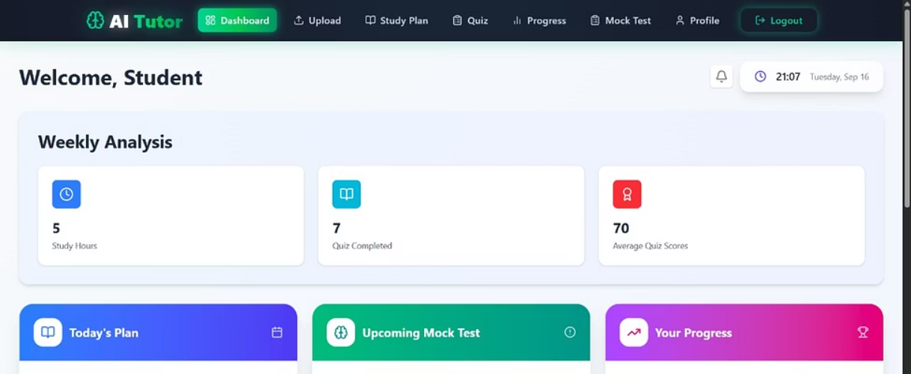
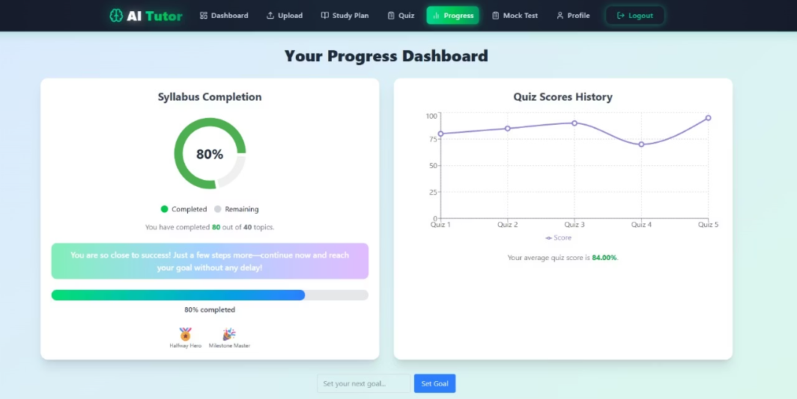
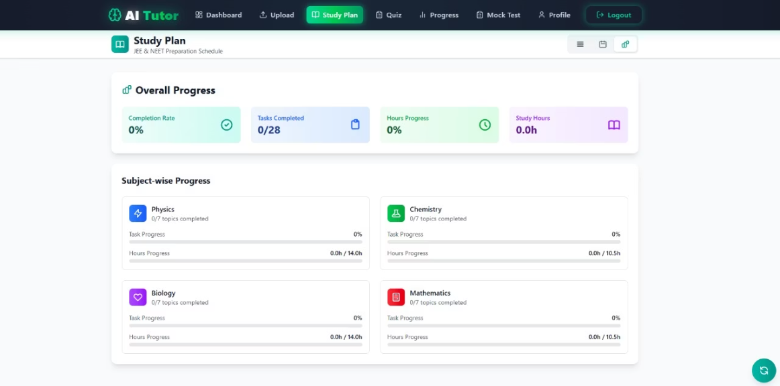
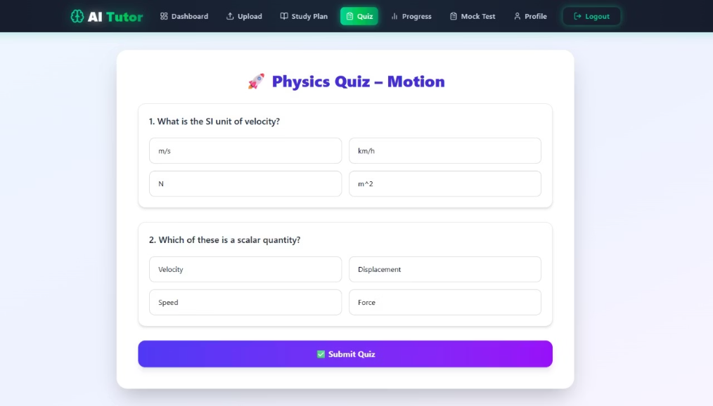
Glimpse Of User Interface
Dashboard
Progress
Study Plan
Quiz Interface

Slide 7





Learnings
Project Structuring
Organizing code, modules, and project architecture for scalability and maintainability was crucial.
Team Work
Effective collaboration, coordination, and working together were essential for bringing our vision to life.
Importance of Communication
Clear communication, comprehensive documentation, and regular stakeholder updates ensured everyone was aligned.
Use of GitHub
Leveraging GitHub for version control, collaborative development, and efficient code management streamlined our workflow.
"Building AI Tutor taught us how to balance sophisticated technology with intuitive user experience."

Slide 8
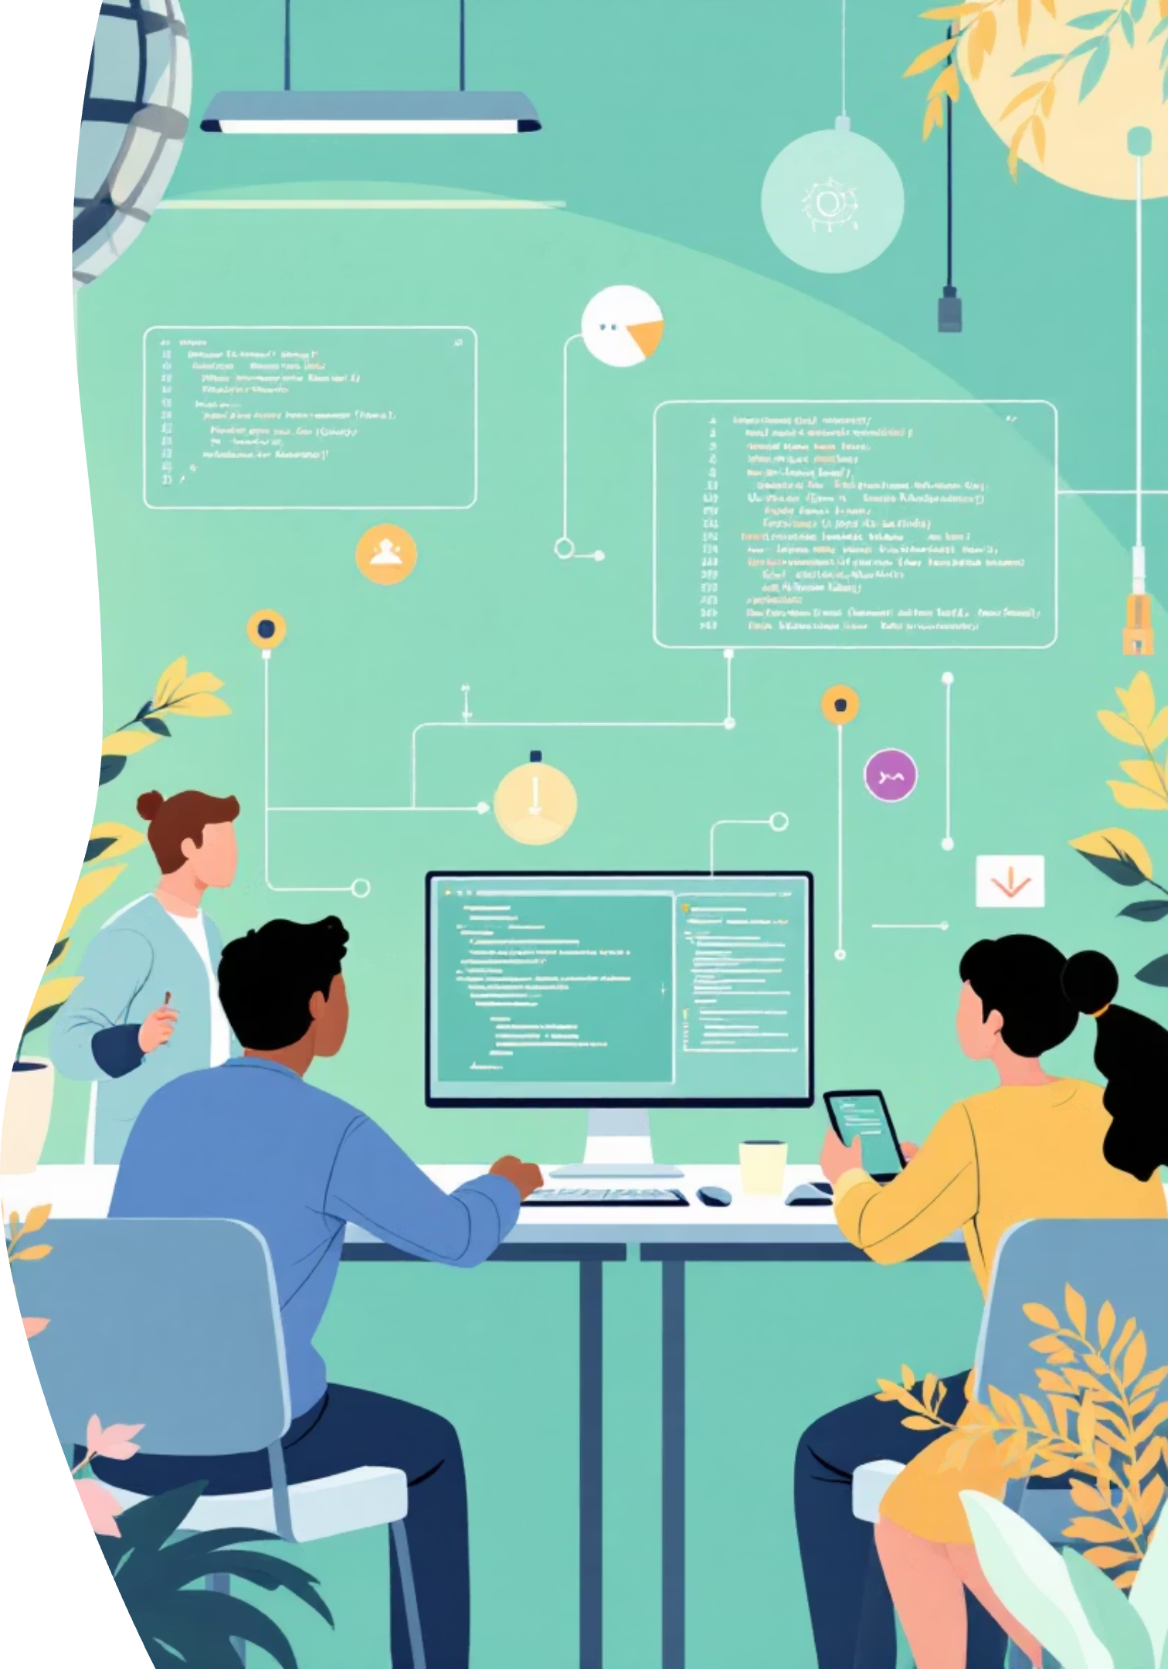
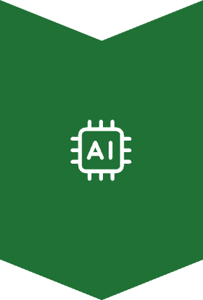



Future Advancements
Multi-Modal Learning
Seamless integration of educational videos and external resources based on syllabus topics.
Weekly Contests
Introducing competitive, topic-based contests to boost engagement.
Collaborative Learning
Group study plans and peer-to-peer quiz sharing features
AI-Powered Q&A Chatbot/Voice Assistant
A direct line to an AI tutor for instant help with specific queries and hands-free interaction.

Slide 9
Thank You

